Slide 1



Telecom Churn Analysis
To analyze and predict customer churn in the telecom industry.
Understanding churn helps telecom companies retain customers, improve loyalty, and increase profitability

Slide 2


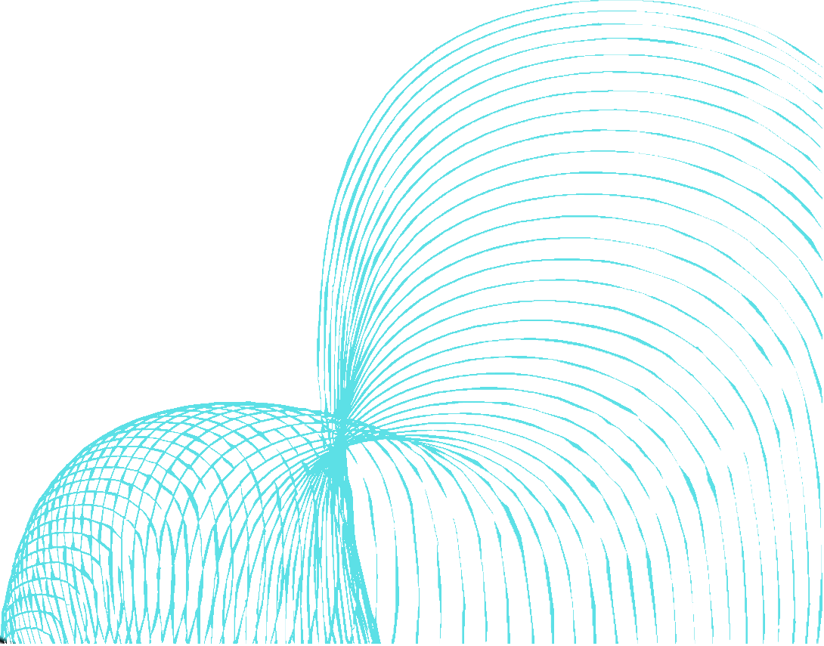
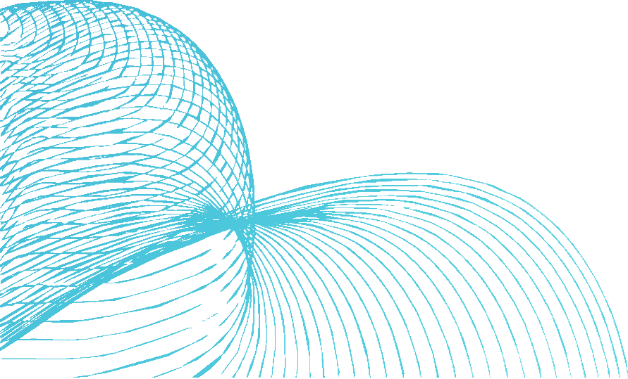
TEAM
Jaya Prakash
Vineeth
Nihal Khan
Bhavani Shankar
Shail Sathe
UNDER THE GUIDENCE OF:
PANAM.SRAVANI
EXCELR HYD

Slide 3
CONTENT
ABSTRACT
What is Churn?
Dataset Overview
Data Cleaning
Exploratory Data Analysis (EDA)
Data Visualization
Feature Engineering
Model Building
Model Evaluation
Performance Feedback
Output
Deployment
Conclusion

Slide 4


ABSTRACT :
In this project, we analyzed and predicted customer churn for a telecom company. Churn refers to the rate at which customers discontinue their services. The dataset contained 5000 entries with 21 features, including service usage metrics, customer plans, and churn indicator. We cleaned the data by dropping irrelevant columns and handling missing values. Exploratory Data Analysis (EDA) was conducted to understand data distributions and correlations. We created new features and encoded categorical variables. A Random Forest Classifier was used to predict churn. The model was evaluated using accuracy, confusion matrix, and classification report. The results indicated that the model performs well, with an accuracy of over 85%. Based on the performance, recommendations were made to further improve the model and reduce churn. This analysis helps telecom companies to understand churn and develop strategies to retain customers and enhance profitability.

Slide 5

What is Churn?
Definition : Churn is the rate at which customers discontinue their services with a telecom operator.
Impact : High churn rates can negatively affect profitability and growth.
Goals : Identifying factors contributing to churn and developing strategies to reduce it.
Churn refers to the rate at which customers discontinue their services with a company. In the context of the telecom industry, it measures how many customers stop using a specific telecom service within a certain period of time. High churn rates can negatively impact a company's profitability and growth by reducing their customer base. Understanding and reducing churn is crucial for ensuring long-term success and customer loyalty.

Slide 6


Dataset Overview
State: Categorical, for the 51 states and the District of Columbia.
Area.code
Account.length: how long the account has Business Objective
Been active.
voice.plan: yes or no, voicemail plan.
voice.messages: number of voicemail messages.
intl.plan: yes or no, international plan.
intl.mins: minutes customer used service to make international calls.
intl.calls: total number of international calls.
intl.charge: total international charge.
day.mins: minutes customer used service during the day.
day.calls: total number of calls during the day.
day.charge: total charge during the day.
eve.mins: minutes customer used service during the evening.
eve.calls: total number of calls during the evening.
eve.charge: total charge during the evening.
night.mins: minutes customer used service during the night.
night.calls: total number of calls during the night.
night.charge: total charge during the night.
customer.calls: number of calls to customer service.
churn: Categorical, yes or no. Indicator of whether the customer has left the company (yes or no).
Source : Dataset with 5000 entries.
Features : 21 columns

Slide 7

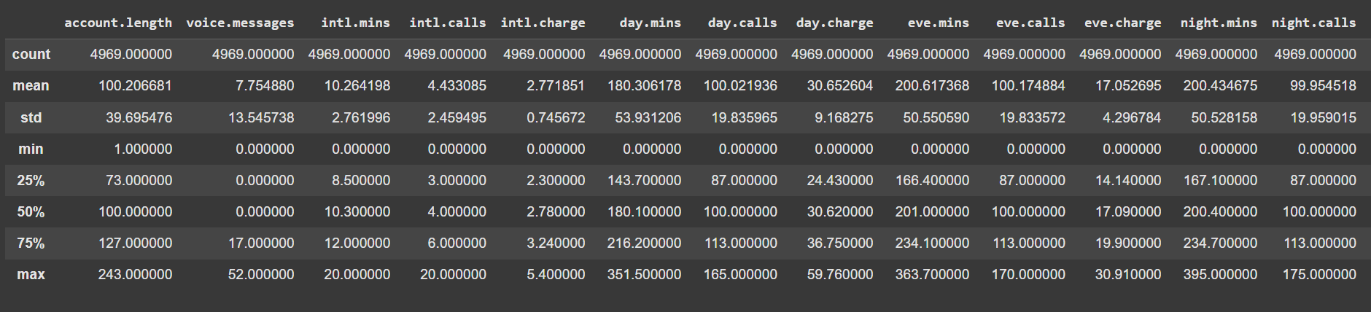
Data Cleaning
Actions Taken:
Dropped irrelevant columns.
Converted necessary columns to numeric values.
Handled missing values by dropping rows with NaNs.

Slide 8

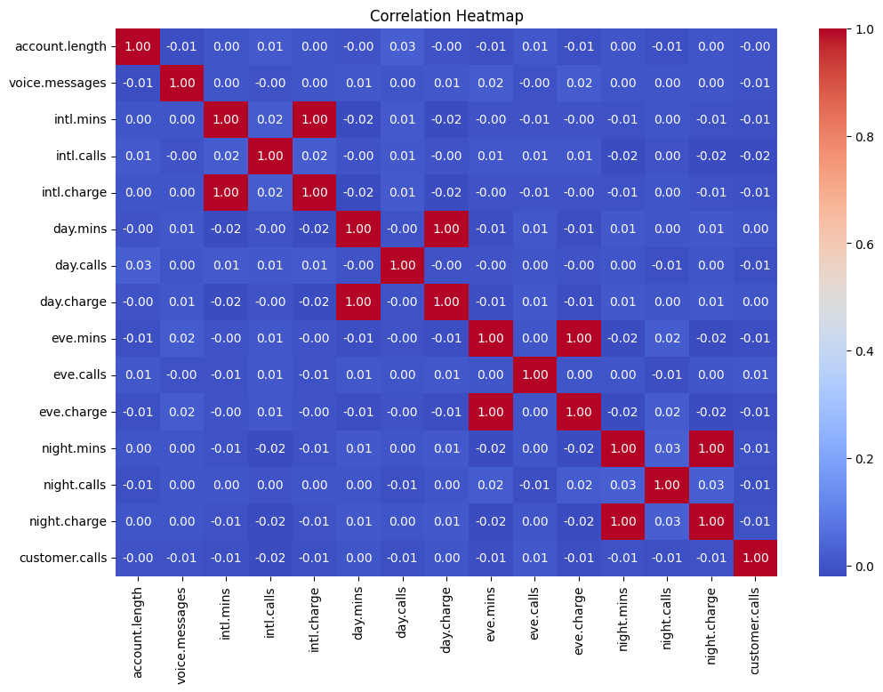
Exploratory Data Analysis (EDA)
Summary Statistics : Overview of the dataset
Distribution of Churn : Visualization of churn rate.
Correlation Heatmap : Show correlations between numerical features.

Slide 9


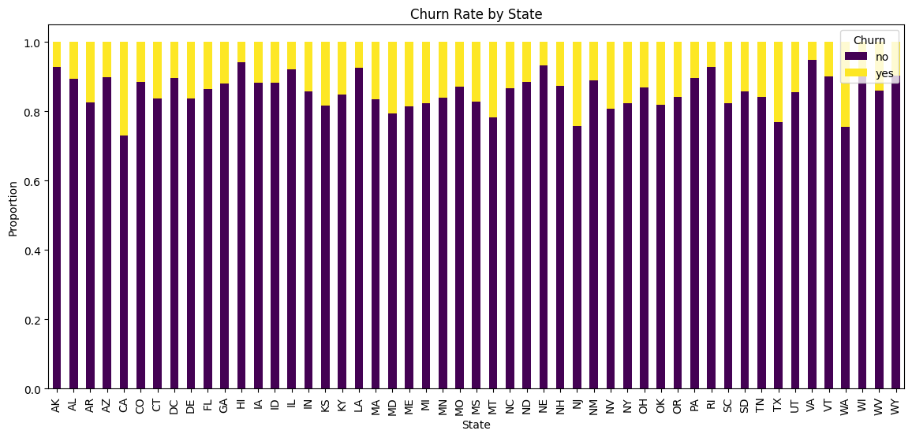
Data Visualization
Churn by State : Stacked bar chart of churn rate by state.
Day Charge vs Churn : Boxplot comparing day charge with churn.

Slide 10
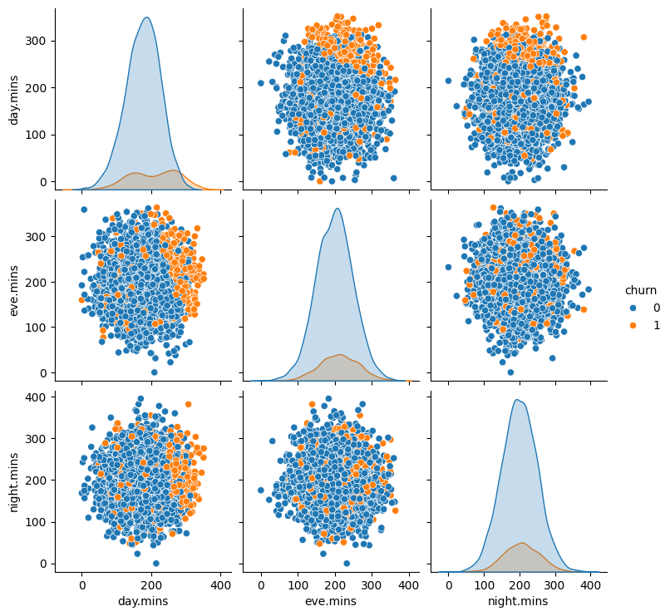
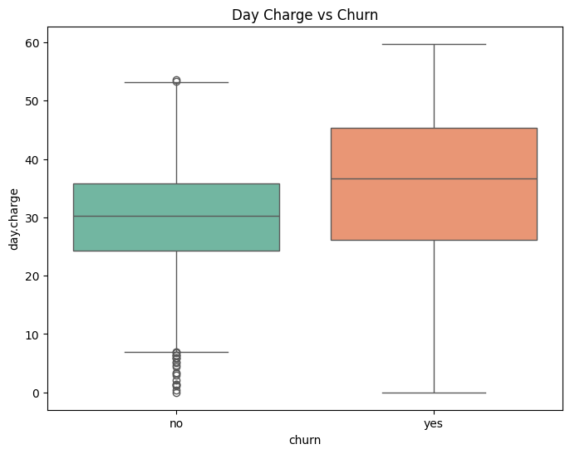
Data Visualization
Pair Plot
Boxplot

Slide 11


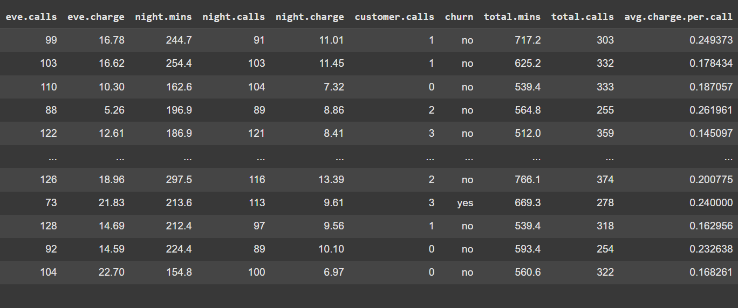
Feature Engineering
New Features Created :
Total minutes of usage
Total number of calls.
Average charge per call.
Encoding Categorical Variables:
Converted 'yes'/'no' to binary values

Slide 12

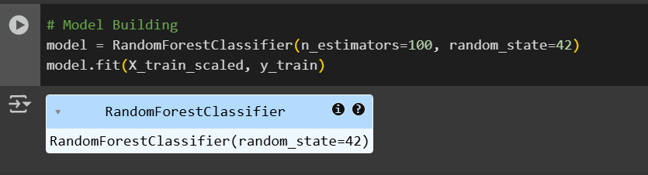
Model Building
Algorithm Used : Random Forest Classifier Data Splitting : 80% training and 20% testing
Scaling : Standardized numerical features

Slide 13
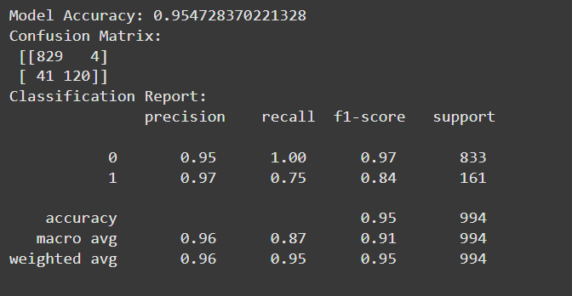
Model Evaluation
Metrics :
Accuracy : 0.95
Confusion Matrix
Classification Report

Slide 14
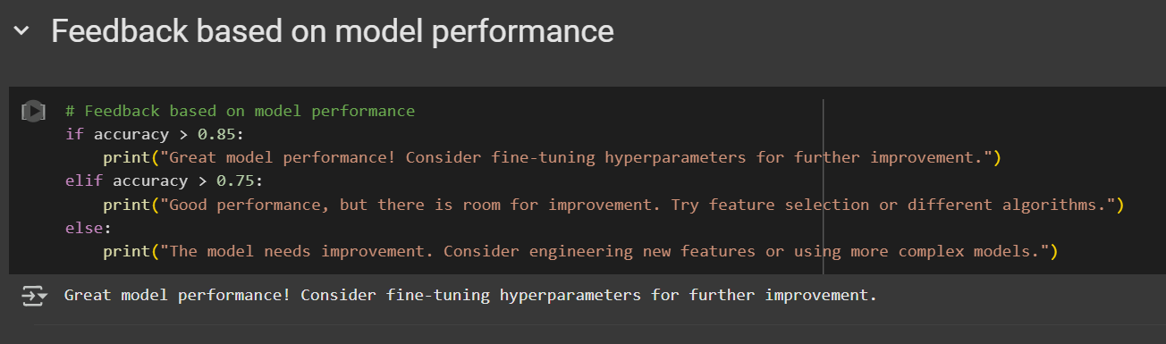
Performance Feedback
Results Interpretation:
Accuracy greater than 85% : Excellent model performance, consider hyperparameter tuning.
Accuracy between 75%-85% : Good performance, explore feature selection or different algorithms.
Accuracy below 75% : Needs improvement, consider engineering new features or using more complex models.

Slide 15
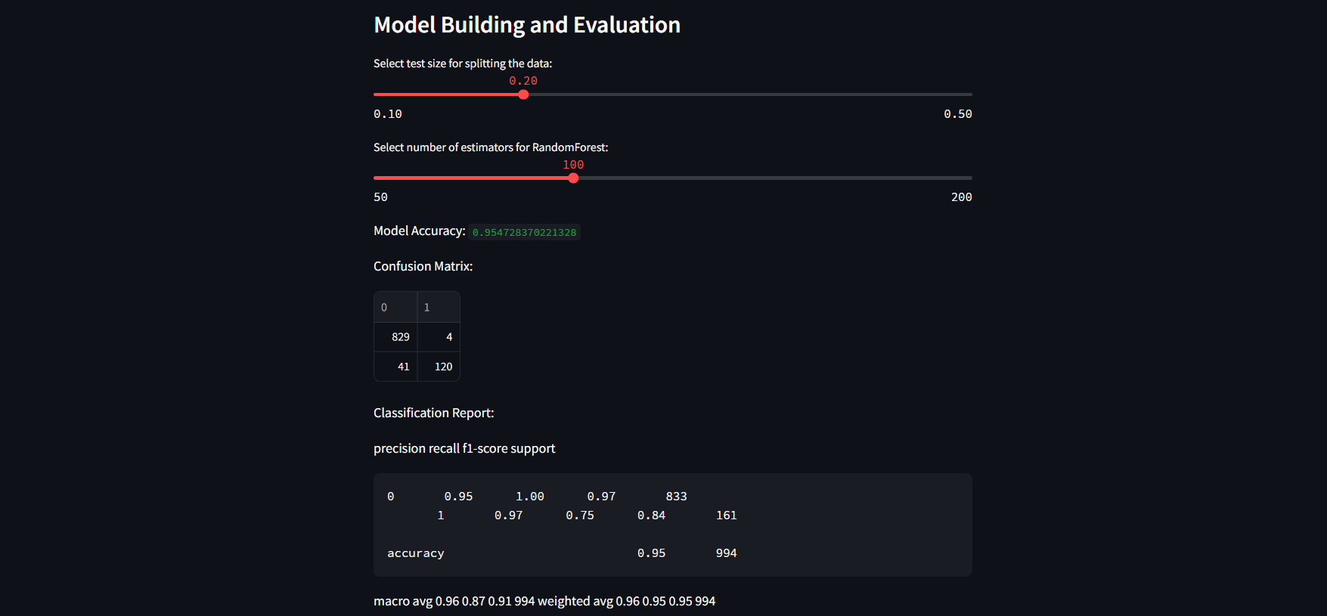
Deployment
I deployed the model using Streamlit, creating an interactive web application where users can upload their data and get churn predictions. The deployment process involved integrating the trained model into the Streamlit app and ensuring smooth user interaction.

Slide 16


CONCLUSION
In this project, we successfully analyzed and predicted customer churn for a telecom company. Through data cleaning and Exploratory Data Analysis (EDA), we gained insights into the dataset's structure and the factors contributing to churn. By creating new features and encoding categorical variables, we improved the dataset's quality for modeling. Using a Random Forest Classifier, we achieved an impressive accuracy of over 85%, indicating the model's effectiveness in predicting churn.
Key findings included the impact of usage metrics and customer service calls on churn. Based on the analysis, we recommend telecom companies focus on improving customer service, offering personalized plans, and targeting high-risk customers with retention strategies. Future work could involve more advanced modeling techniques and deeper analysis of specific customer segments to further enhance churn prediction and retention strategies.

